Slide 1
An Introduction to Network Analysis in R
Laura W. Dozal
RezBaz 2022

Slide 2
Who is this workshop for?
Beginners
What will this workshop be like?
Concepts, application in R, & interpretation of outputs
No equations
Textbook definitions & code included
What do we aim for?
Idea of what network analysis is
Answer to questions: Does network analysis interest me? Is it the right method for my project?
Smooth entry point
What you
can expect
Before we start:
Log in to GitHub
Get the data & unzip the data
Install packages

Slide 3
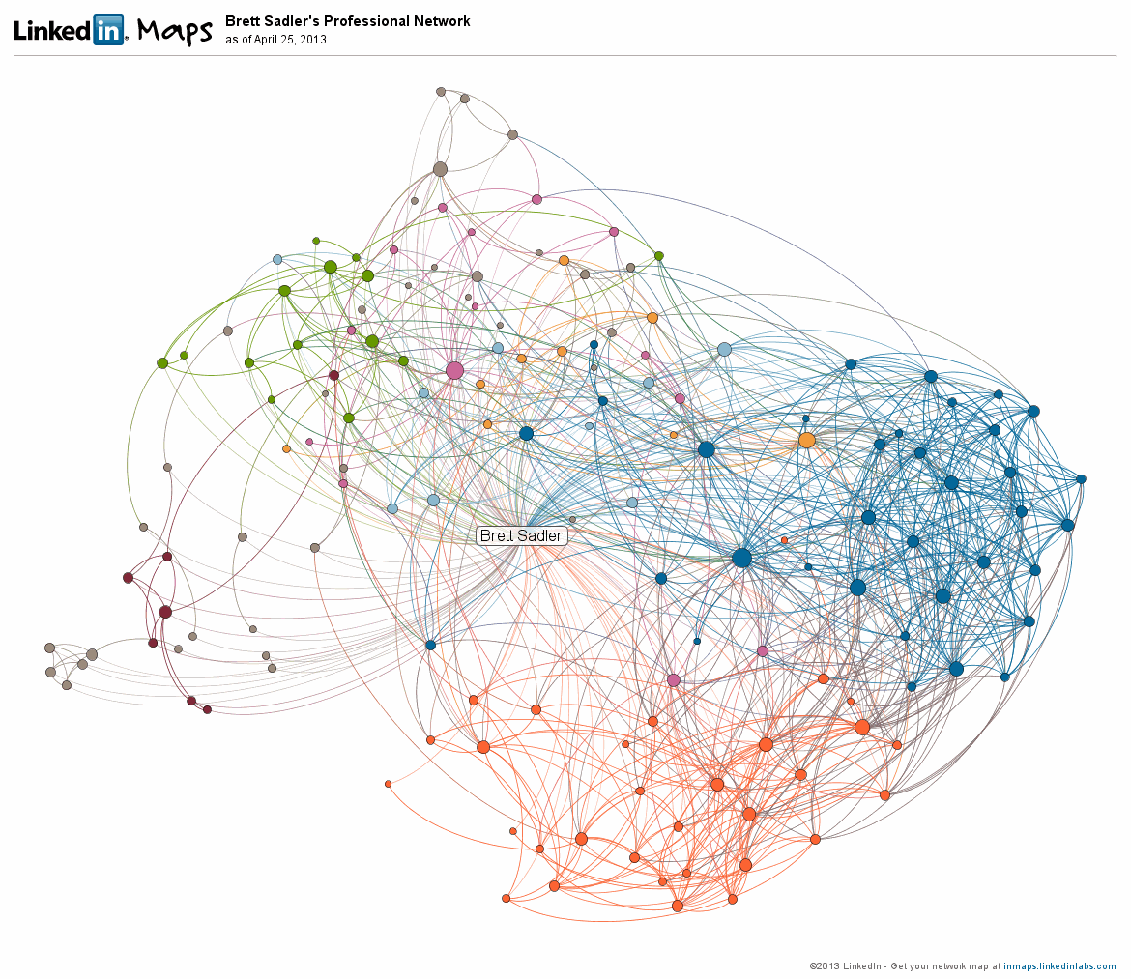
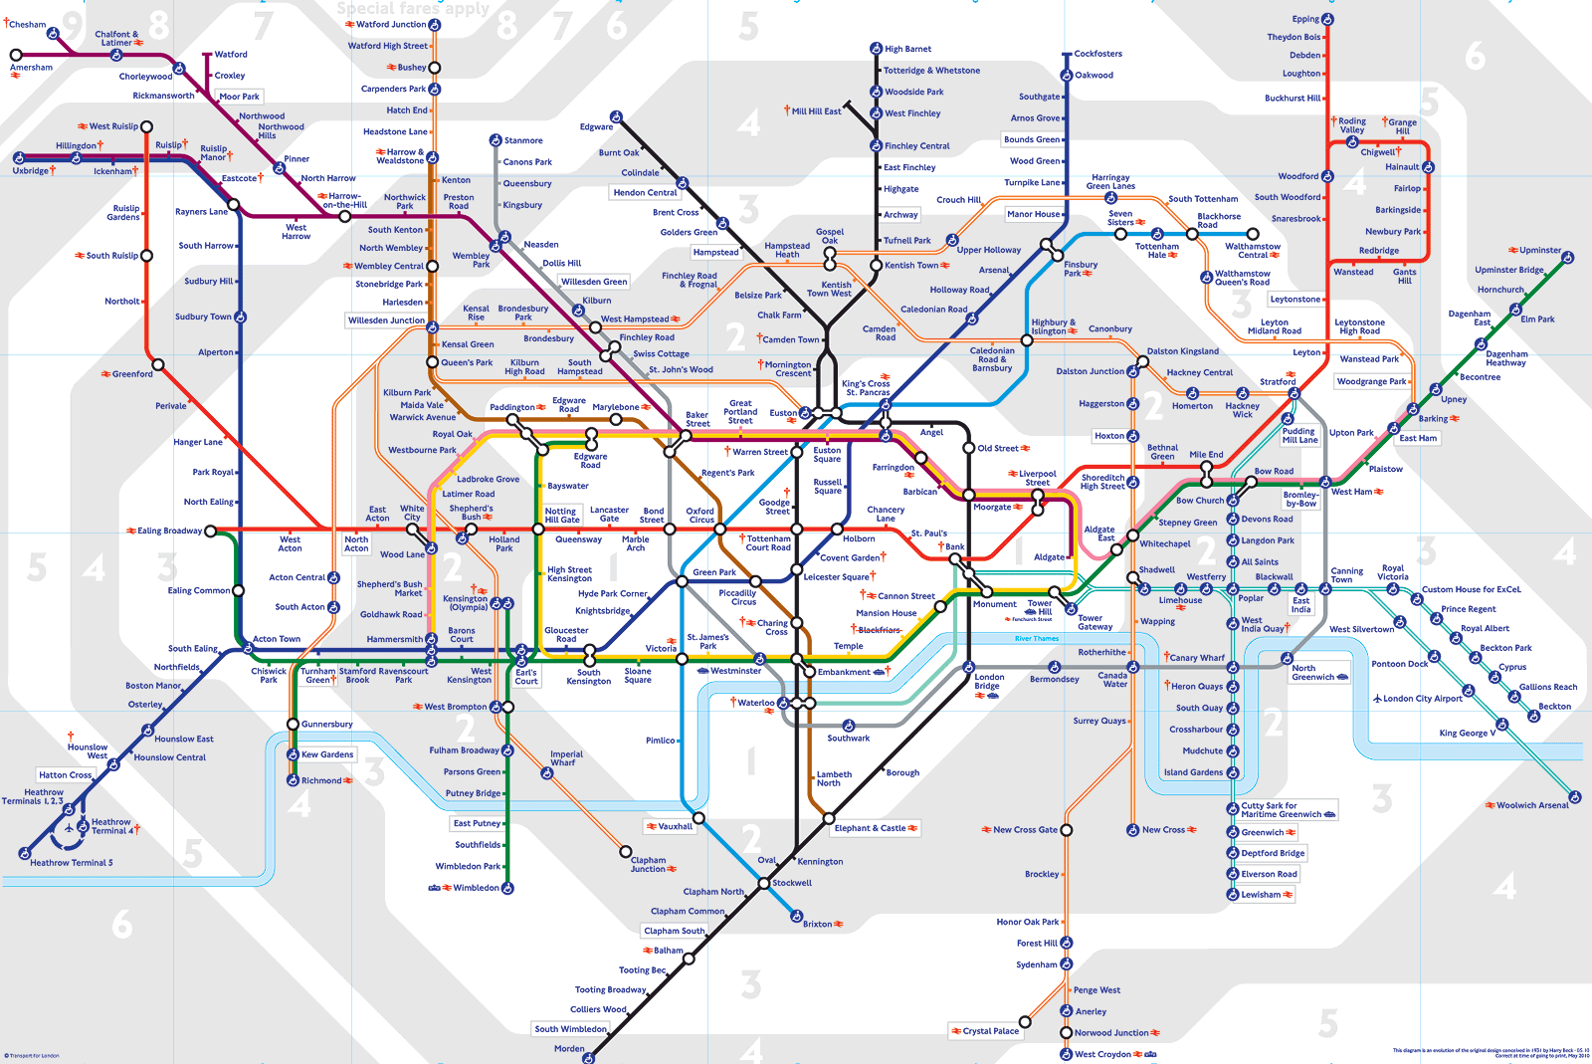
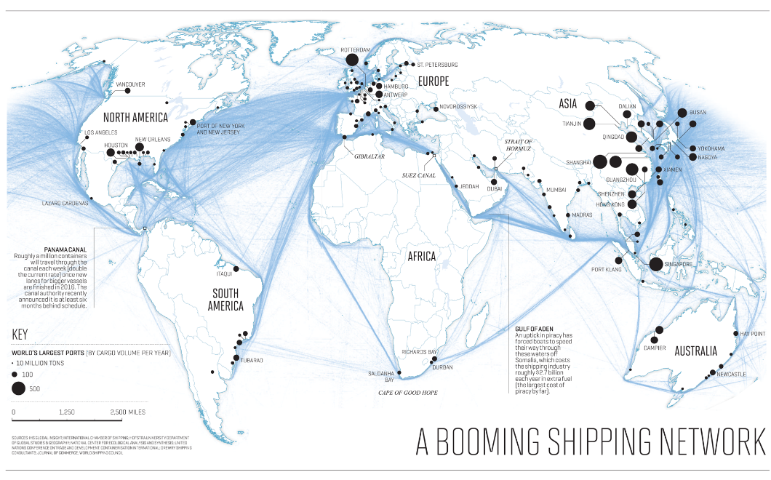
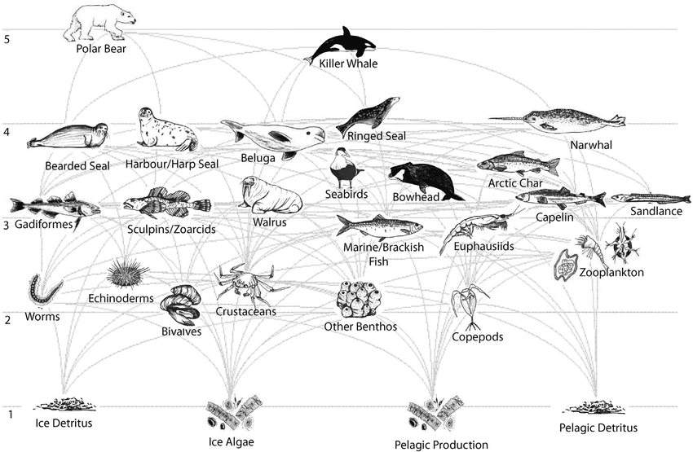
Networks are everywhere …
LinkedIn Connections
London underground
For sources of graphs, see last slide.
Marine ecosystem network
Shipping network
Notes:
How communities, groups and nodes cluster to function as business connections, urban navigation, shipping communications, and ecosystems.

Slide 4
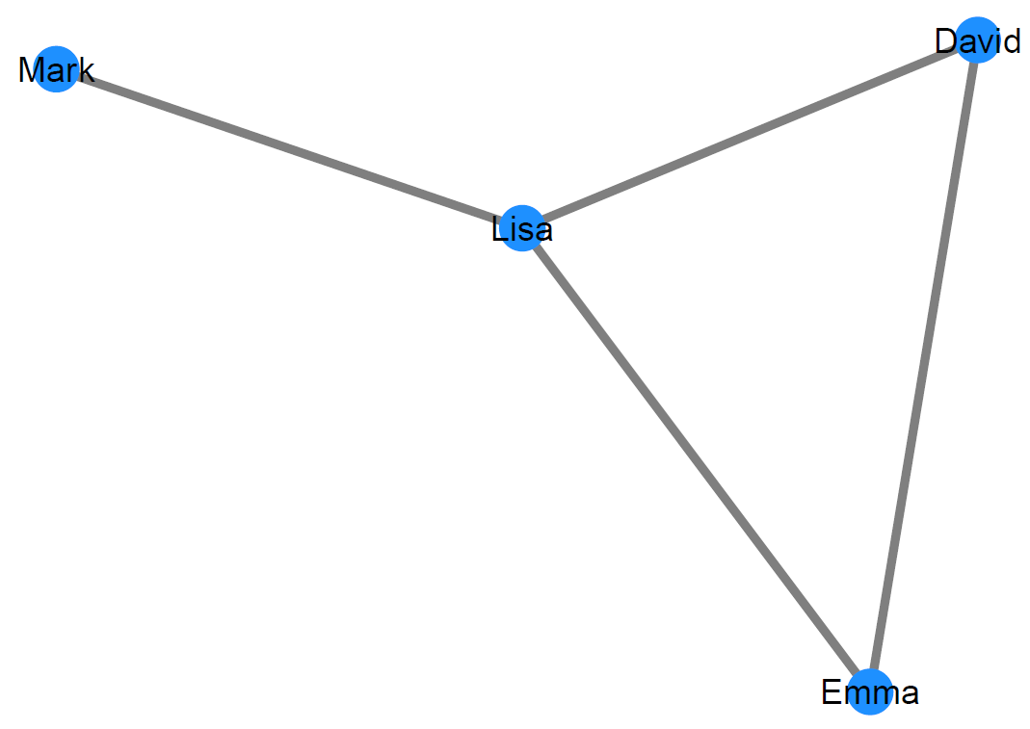
Node
Let’s get down to the basics
From networks to network analysis
Representation as nodes (N) and edges (E) G = (N, E)
Edge
Notes:
In network analysis the fundamental piece of information is a relationship between two members of a network, also called a tie, where an edge connects two nodes.

Slide 5
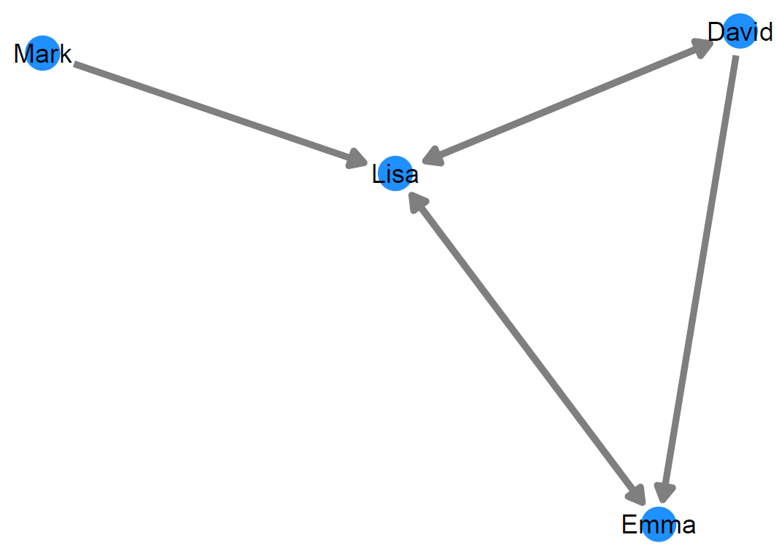
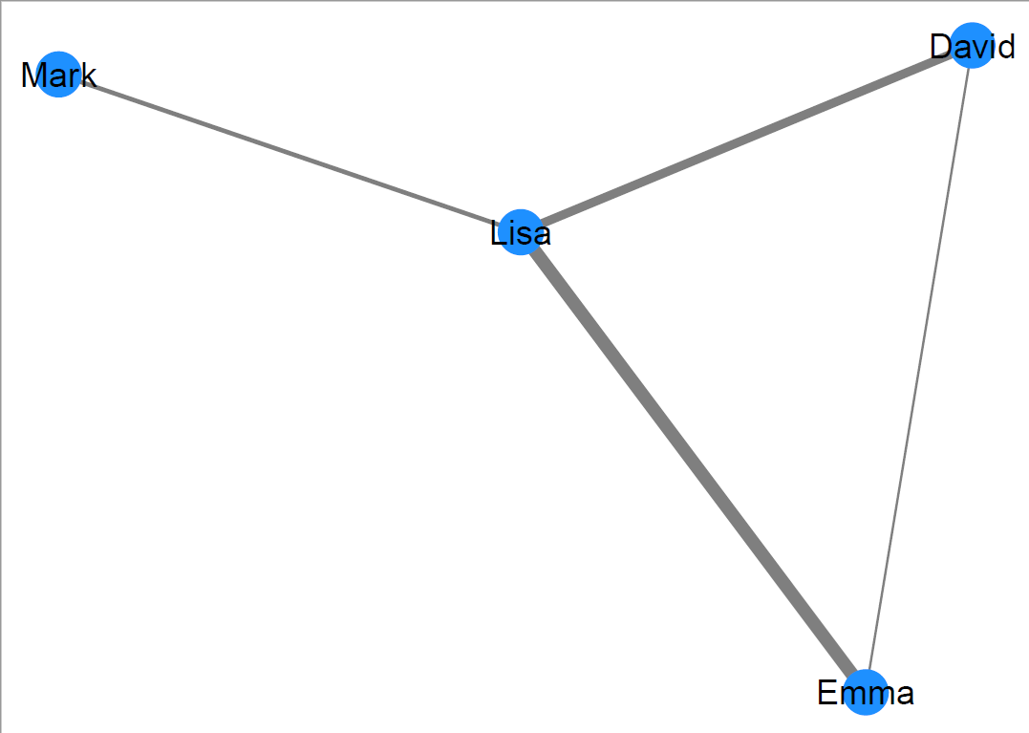
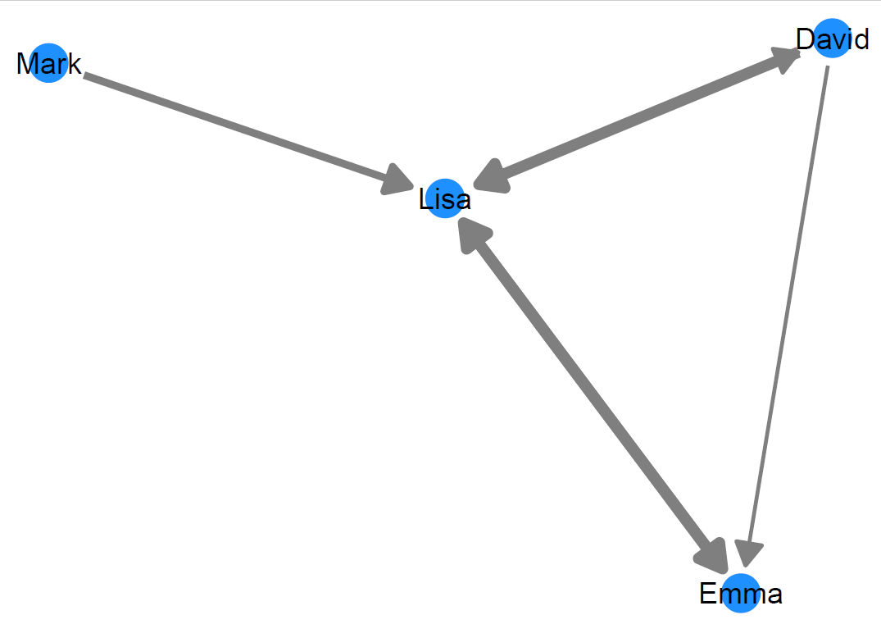
Let’s get down to the basics
unweighted
From networks to network analysis
Representation as nodes (N) and edges (E) G = (N, E)
Edges can be …
… undirected or directed
… unweighted or weighted
undirected
directed
Vocabulary note:
Nodes are also called vertices or actors
Edges are also called ties or links
weighted
Notes:
Directed ties AKA arcs, they show a clear sender and receiver; can sometimes mean hierarchy
Undirected ties AKA edges, where there is a tie between two nodes without a clear direction
unweighted graphs, if there is a connection between vertex i and j, then the value of the cell [i,j] will equal 1, if there is not a connection, it will equal 0.
Weighted graphs, the value of 1 is replaced with the "cost" of the edge, and the connectionless cells can be changed to the infinity symbol
https://iq.opengenus.org/adjacency-matrix/#:~:text=An%20adjacency%20matrix%20is%20a,connection%2C%20it%20will%20equal%200.

Slide 6
Let’s get down to the basics
From networks to network analysis
Representation as nodes (N) and edges (E) G = (N, E)
unipartite
Edges can be …
… undirected or directed
… unweighted or weighted
Networks can be …
… unipartite
… bipartite
Specificity note:
Every edge must connect a node from one set to the other
bipartite
Notes:
Unipartite network has one set, whereas a bipartite network has two disjoint independent sets that connect to each other.
Note, every edge must connect a node from both sets.

Slide 7
Let’s get down to the basics
From networks to network analysis
Representation as nodes (N) and edges (E) G = (N, E)
Hypergraph
Edges can be …
… undirected or directed
… unweighted or weighted
Networks can be …
… unipartite
… bipartite
Limitation: We usually do not model …
… Hypergraphs
… Multigraphs
Note:
These are mainly used for advanced graph theory mathematics and deeper network analysis.
They have also been used in some deep learning
Multigraph
Notes:
Hypergraph is a generalization of a graph in which an edge can join any number of vertices. In contrast, in an ordinary graph, an edge connects exactly two vertices.
Multigraph is a Graph where multiple parallel edges can connect the same nodes; holds undirected edges and self loops are allowed.

Slide 8
Representing networks (data formats)
Mark | Lisa
Lisa | David
Lisa | Emma
Emma | David
Edgelist
 | Mark | Lisa | David | Emma
Mark | 0 | 1 | 0 | 0
Lisa | 1 | 0 | 1 | 1
David | 0 | 1 | 0 | 1
Emma | 0 | 1 | 1 | 0
Adjacency matrix (AKA sociomatrix)
Notes:
Edgelists list every tie in the network; each row corresponds to a tie that goes from the node listed in the first column to the node listed in the second. Edgelists are usually more efficient for large networks
Adjacency matrices, AKA sociomatricies are square matrices where 1 indicated a tie between two nodes and 0 indicates no ties. You start with the rows that send the information and columns receive the information.
If a network is non-directed, then the sociomatrix would be symmetric and diagonal. For a simple network there are no self loops, where a tie connects back to its own node, for example, here is a simple non-directed adjacency matrix.

Slide 9
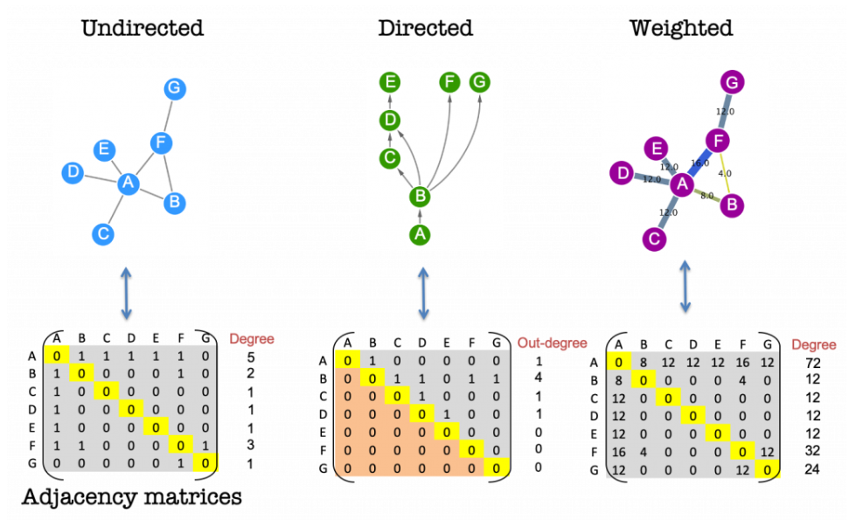
Representing networks (data formats)
Notes:
https://www.ebi.ac.uk/training/online/courses/network-analysis-of-protein-interaction-data-an-introduction/introduction-to-graph-theory/graph-theory-adjacency-matrices/

Slide 10
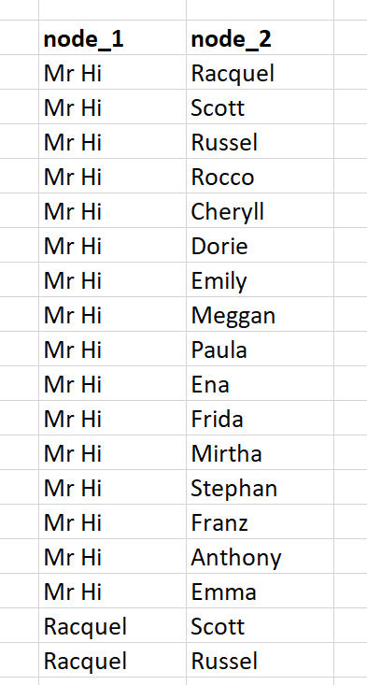
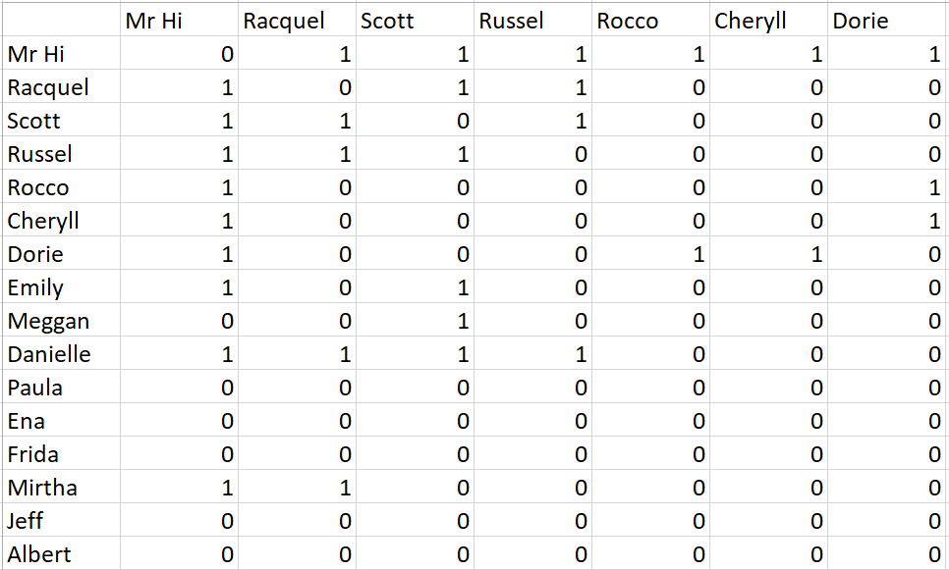
Today’s network
Data from study by Zachary (1977)
Social network between members of a university karate club
Observed from 1970 to 1972
Two individuals are linked, if they regularly interact outside of the karate club
A
B
Questions
What are the formats called? A?, B?
Is this network directed or undirected?
Weighted or unweighted?
Which format would you prefer? Why?
Note on dataset:
(1) Data was collected by Zachary (1977). The data as used in this course was taken from the R package igraphdata (Csardi, 2015). Infromation on node attributes was added from the original study.
(2) The original dataset does not contain any names. Names were added by LB for educational purposes and are random.
Notes:
What are the formats called? A? “Edge” B? “Adjacency Matrix or Sociomatrix”
Is this network directed or undirected? “Undirected”
Weighted or unweighted? “Unweighted”
Which format would you prefer? Why?

Slide 11
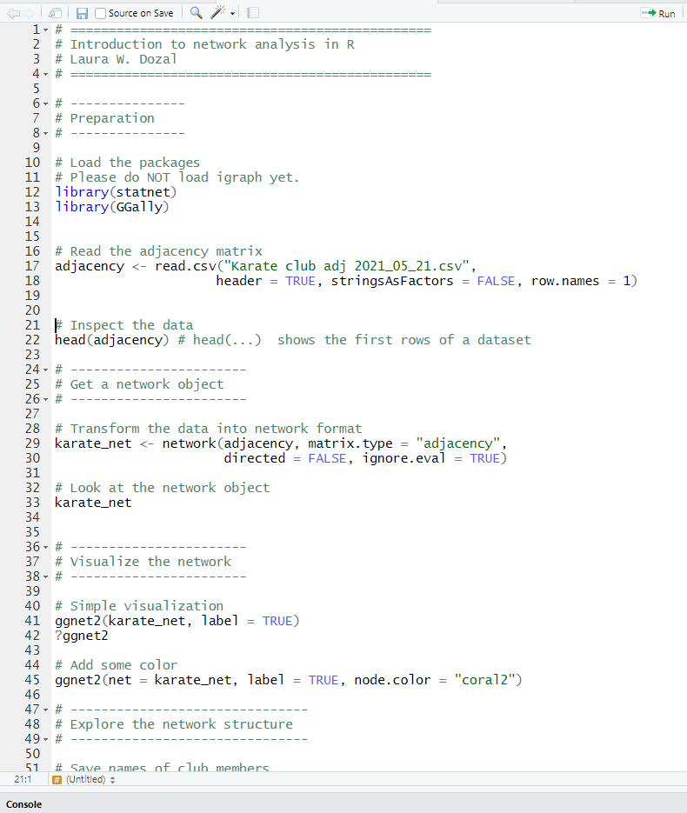
Visualizing Networks

Slide 12
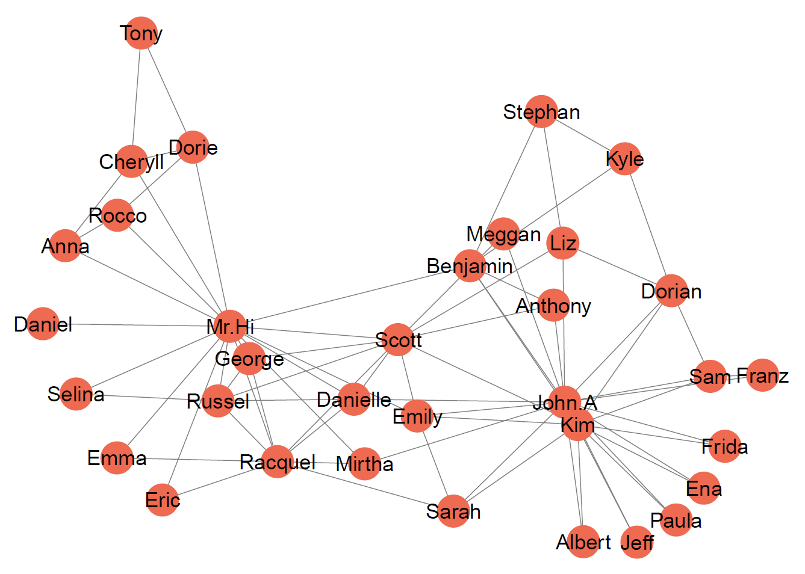
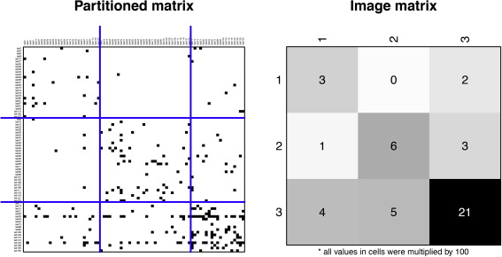
Visualizing networks
Random Viz example – Žiberna, 2014
Notes:
One affordance of network analysis is the ability to observe and analyze connections as a visual component. Some visuals are more useful for some things, and some for others.
https://doi-org.ezproxy2.library.arizona.edu/10.1016/j.socnet.2014.04.002

Slide 13
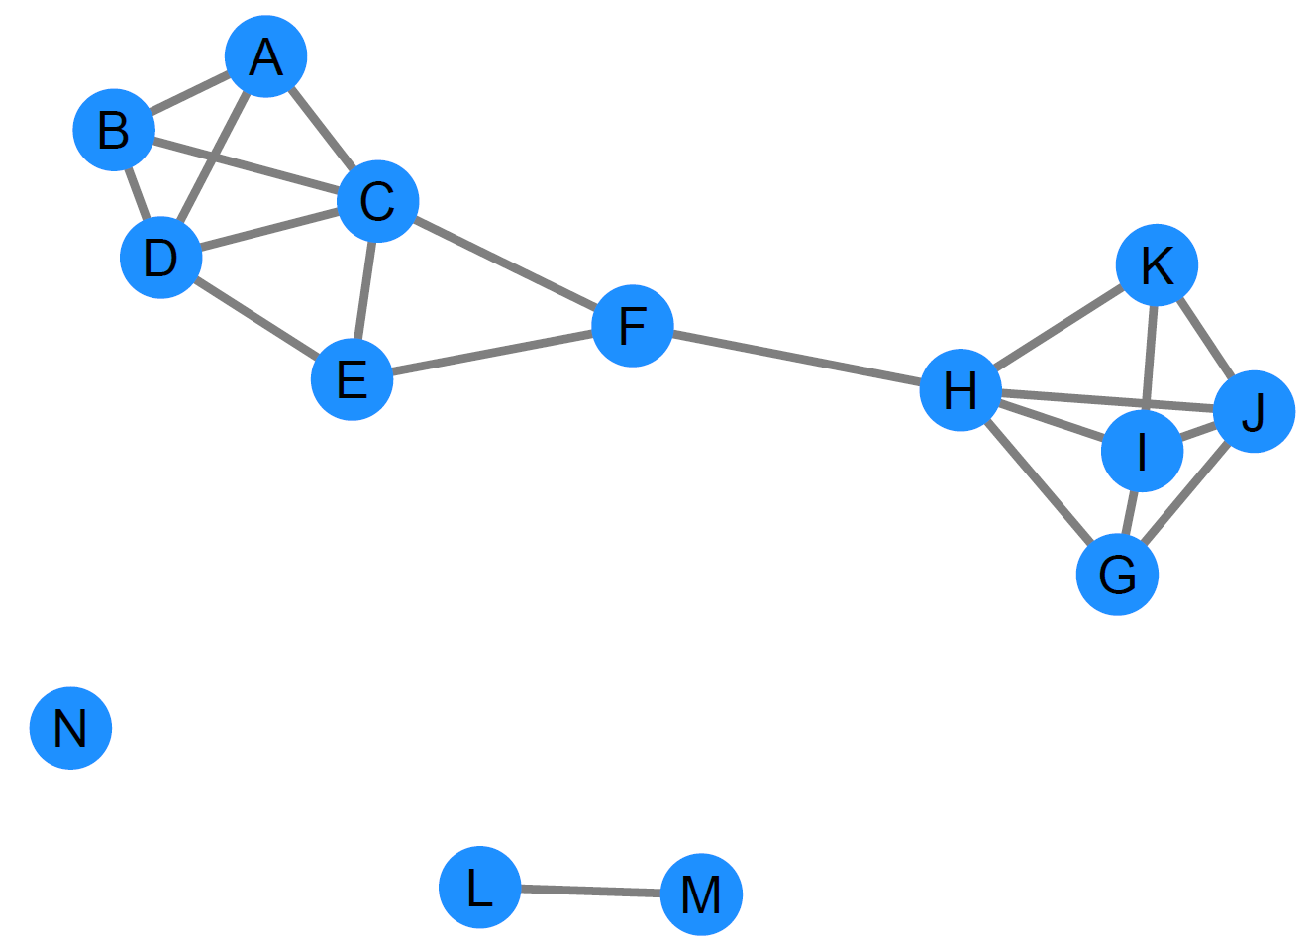
Looking at the network
Components Maximal subset of nodes that can reach one another
Isolates Nodes with no links.
Density Proportion of links that could exist that actually do exist.
Transitivity
A->B->C then, A->C
Reciprocity
When information sent from one node to another is reciprocated.
Notes:
Components: Very basic type of subgroup in a network in which all nodes are connected directly or indirectly.
Isolates, for today’s purpose, we won’t think of them exactly as outliers but isolated nodes with no connection to others.
Density – the proportion of observed ties (which can be edges, arcs, or relations) in a network to the maximum number of possible ties.
- When the density is closer to 1, the network is more interconnected.
It does not allow ties between a particular node and itself (i.e. loops)
Transitivity, usually in a triad form, but not always, if a is linked to b and b is linked to c then a and c are linked. i.e. friend of a friend of a friend.
Reciprocity, for directed edges, if someone sends information one way it is reciprocated. So help, advice, money can all be reciprocated, but the type of reciprocation can vary.

Slide 14
Component
“A component is defined as a maximal set of nodes in which every node can reach every other by some path. The ‘maximal’ part means that if you can add a node to the set without violating the condition, that everyone can reach everyone, you must do so.” (Borgatti, Everett, & Johnson, 2013, p.16)
Isolate
Nodes with no connection. (see Borgatti, Everett, & Johnson, 2013, p.14)
Density
“Density is simply the number of ties in the network, expresses as a proportion of the number possible. In an ordinary undirected non-reflexife graph, the number possible is n(n-1)/2, where n is the number of nodes. Density can be interpreted as the probability that a tie exists between any pair of randomly chosen nodes; however, the absolute number can be hard to assess. Whether a density of, say 0.345 should be considered high or low depends.” (see Borgatti, Everett, & Johnson, 2013, p.150-151)
Transitivity
“For many social relations we might expect that if A is related to B and B is related to C then there would be a relationship from A to C. When this is the case, we say the triad is transitive. One way to think of this is that the friends of your friends are your friends. When networks have a lot of transitivity, they tend to have a clumpy structure. That is, they contain knots of nodes that are all interrelated. To measure this tendency toward transitivity we count up, across all possible triads, the proportion of triads in which A -> B and B -> C that also have A -> C.” (Borgatti, Everett, & Johnson, 2013, p.156)
Reciprocity
If ties are directed, we are often interested in the extent to which a tie from A to B is matched by one from B to A. Hence, if we have relations such as ‘helps’, ‘gives advice to’ or ‘lends money to’ and the amount that these are reciprocated varies greatly for similar networks then we may wish to investigate if there is some underlying reason (e.g., hierarchy, wealth inequality or cultural taboo). A simple measure to reciprocity is simply to count the number of reciprocated ties and divide these by the total number of ties.” (Borgatti, Everett, & Johnson, 2013, p.155)
Looking at the whole network (textbook definitions)

Slide 15
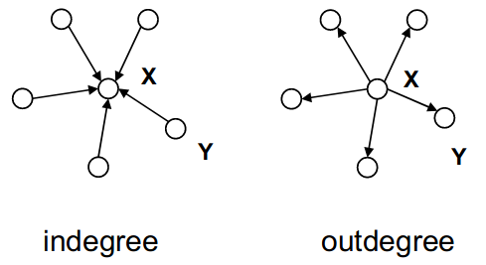
Looking at individual actors
Centrality Node’s position in a network
Degree centrality Number of links that a nodes has. Indegree and outdegree centrality for directed networks.
Notes:
The centrality of a node can help us figure out its importance in relation to the rest of the network.
There are 3 main centrality measures, Degree, Closeness and Betweeness
Degree centrality -
https://prakhartechviz.blogspot.com/2019/06/concept-of-centrality-in-graphs.html

Slide 16
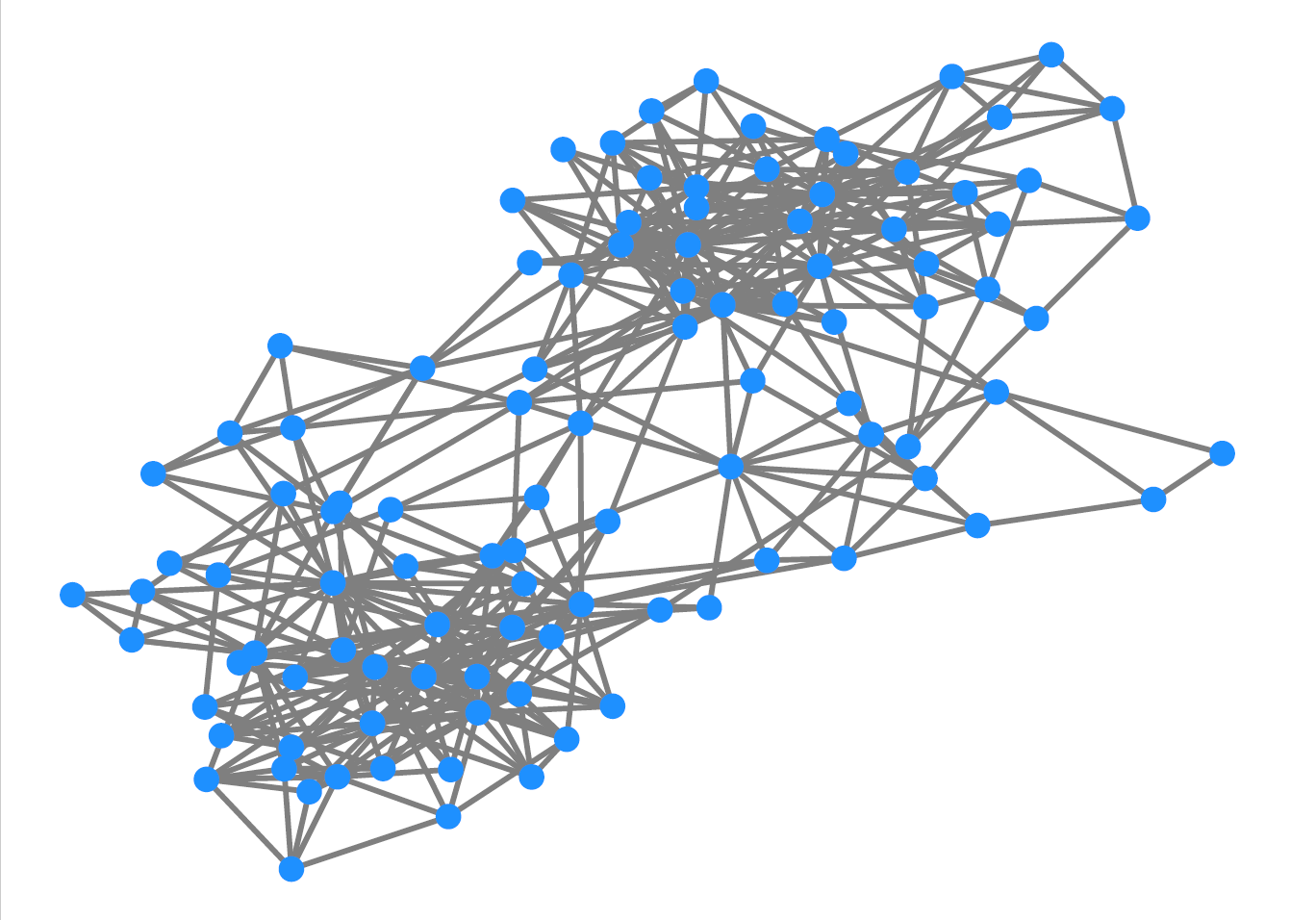
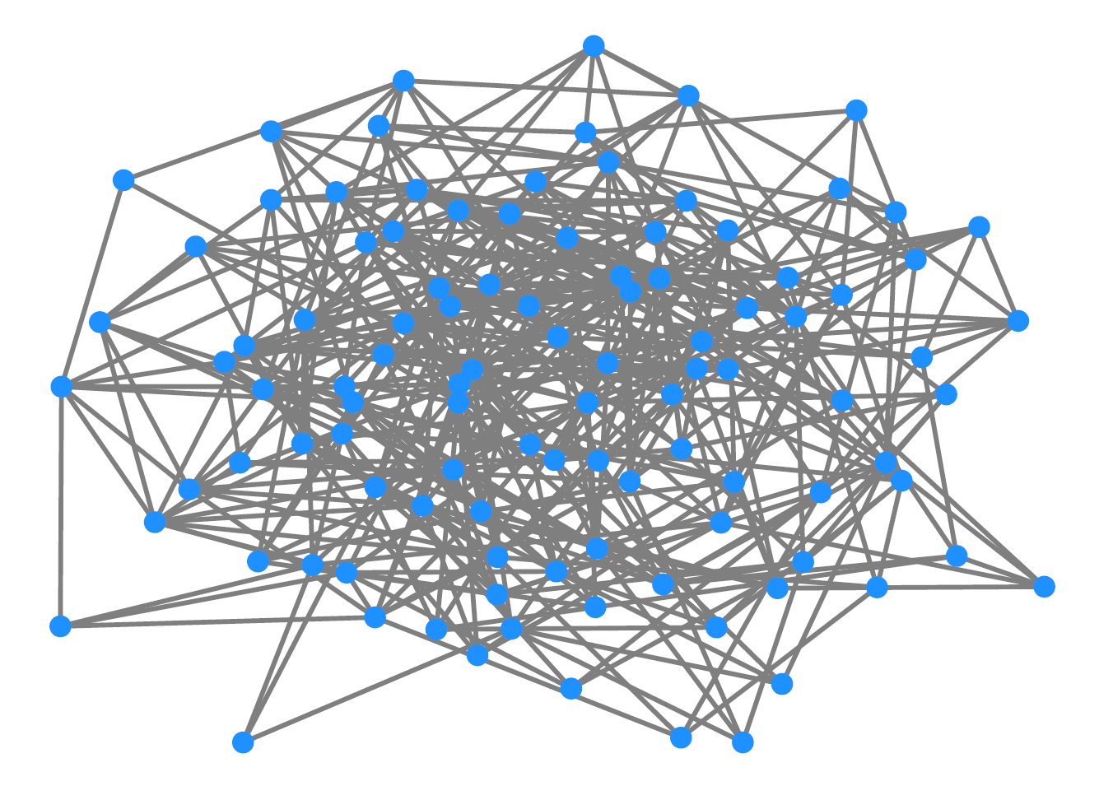
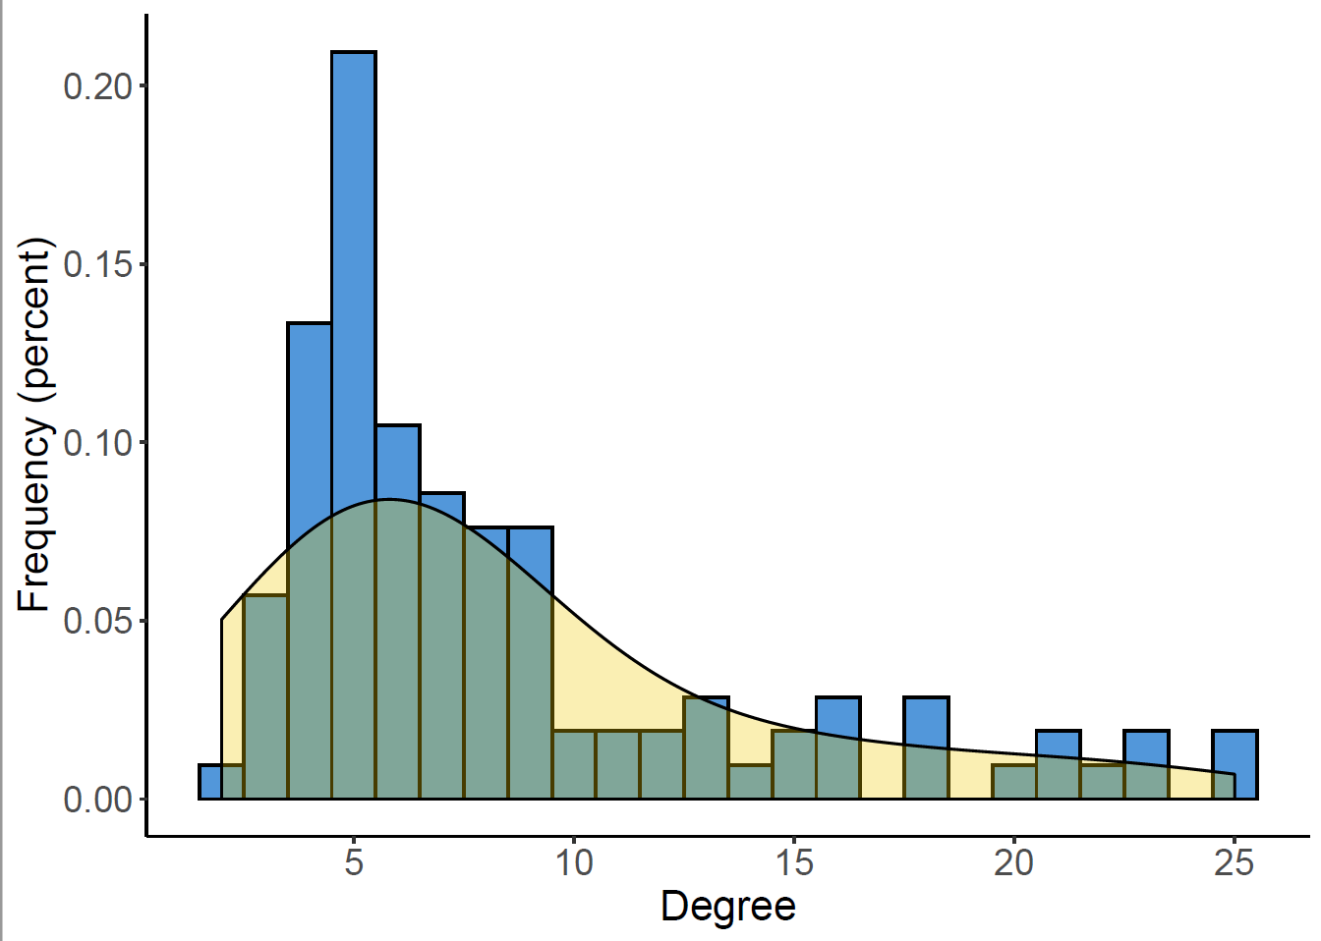
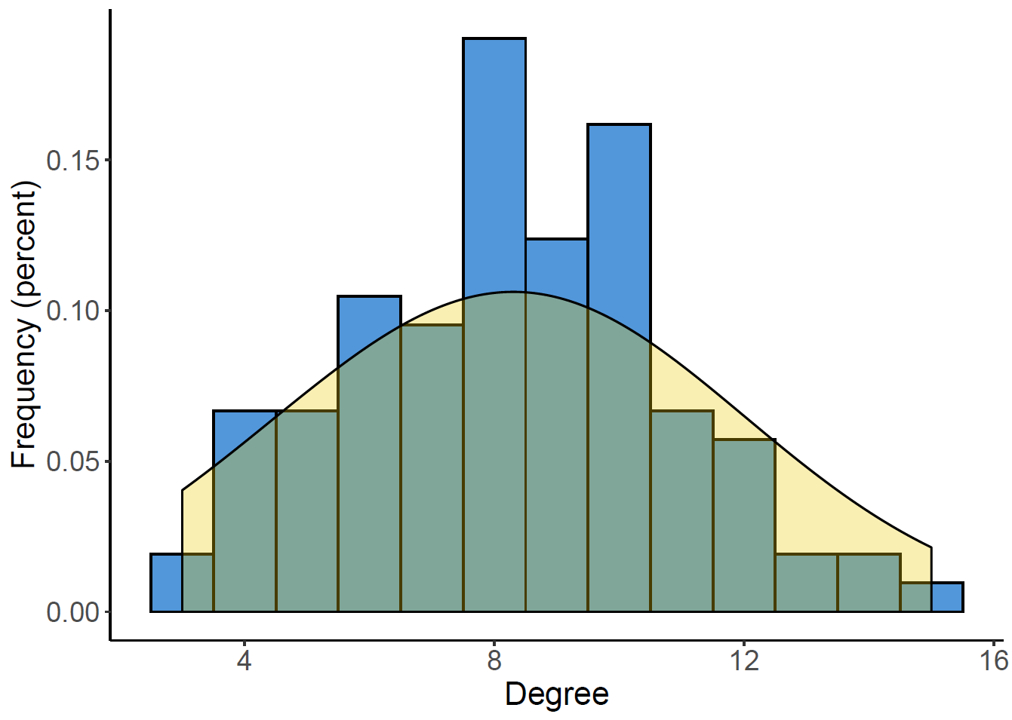
Looking at individual actors
Centrality Node’s position in a network
Degree centrality Number of links that a nodes has. Indegree and outdegree centrality for directed networks. -> Degree Distribution
Eigenvector Centrality
Number of ties a node has, weighted by the centrality of those ties. A node is only as central as its network
Real world network
Comparable random network
Notes:
The degree distribution is the probability distribution of these degrees over the whole network
Much like in intro to stats, real world distributions are usually skewed, showing group subsets where nodes cluster. Whereas random network distributions are similar to a normal or gaussian curve.
Eigenvector centrality – some ties are more central than others, if you’re connected to those ties, you might also be central.
To put this into context, a node with a high degree score (i.e. many connections) may only have a relatively low eigenvector centrality score because many of those connections are with similarly low-scored nodes. Also, a node may have a high betweenness score (indicating it connects disparate parts of a network) but a low Eigenvector Centrality score because it’s still some distance from the centres of power in the network.
You would use eigenvector centrality to identify who or what has a wide-reaching influence within a given network.

Slide 17
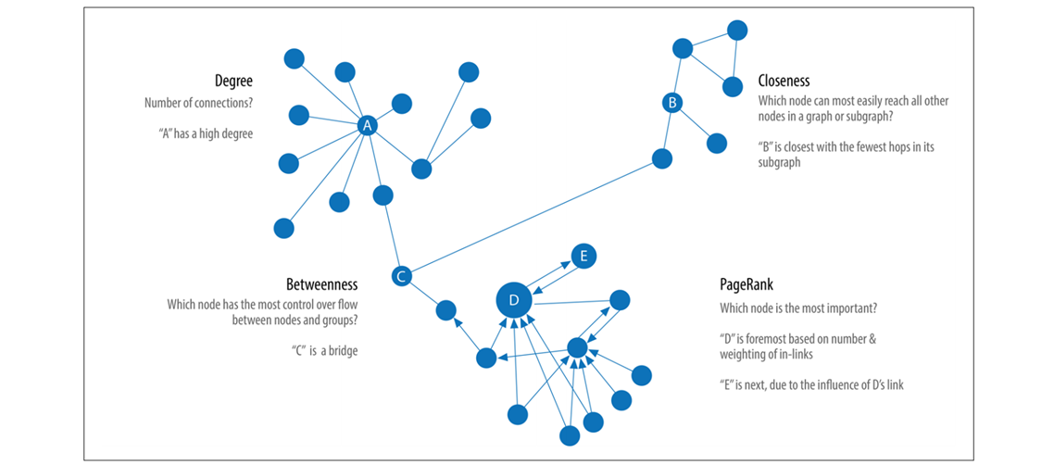
Centrality: A Node’s position in a network
Degree centrality Number of links that a nodes has. Indegree and outdegree centrality for directed networks.
Closeness centrality Sum of geodesic distance from a node to all other nodes.
Betweeness centrality Measure for how often a node is along the shortest path between two nodes.
Eigenvector Centrality
Measures a node’s importance while giving consideration to the importance of its neighbors
Notes:
Closeness – how close a node is to all other nodes in the set of nodes (based on distance, closeness)
- geodesic distance is the shortest path possible from one node to another
Betweeness Centrality – measures the extent to which a particular node lies between the various other nodes in a set of nodes
- i.e. how central is a node in the network by being the “middle-person”, or how essential is the node for facilitating network flow?

Slide 18
Looking at individual actors (textbook definitions)
Centrality - “Centrality is a property of a node’s position in a network. It is not one thing but rather a family of concepts. Loosely speaking, one way to think about node centrality is in terms of the contribution the node makes to the structure of the network. In this sense, we might regard centrality as the structural importance of a node. […] Another way to think about centrality is in terms of the advantage that accrues to a node by virtue of its position in the network.” (Borgatti, Everett, & Johnson, 2013, p.164)
Degree centrality (undirected) - “Perhaps the simplest measure of centrality is degree, which is simply the number of ties of a given type that a node has. […] In terms of the adjacency matrix X of an undirected network, degree centrality is simply the row (or column) sums of the adjacency matrix.” (Borgatti, Everett, & Johnson, 2013, p.165)
Degree centrality (directed) - “Outdegree counts the number of outgoing ties (arcs) whereas indegree counts the number of incoming ties.” (Borgatti, Everett, & Johnson, 2013, p.165)
Eigenvector centrality (undirected) - “[…] a variation of degree centrality in which we count the number of nodes adjacent to a given node (just like degree centrality) but weight each adjacent node by its centrality […] [E]ach node’s centrality is proportional to the sum of centralities of the nodes it is adjacent to—in effect, when it comes to eigenvector centrality, a node is only as central as its network.” (Borgatti, Everett, & Johnson, 2013, p.168)
Closeness centrality (undirected) - “[…] the sum of geodesic distances from node to all others. (Recall that the geodesic distance from a node to another node is the length of the shortest path connecting them.) Closeness is an inverse measure of centrality in the sense that large numbers indicate that a node is highly peripheral, while small numbers indicate that a node is more central.” (Borgatti, Everett, & Johnson, 2013, p.173)
Betweenness centrality (undirected) - “Betweenness centrality is a measure of how often a given node falls along the shortest path between two other nodes. More specifically, it is calculated for a given focal node by computing, for each pair of nodes other than the focal node, what proportion of all the shortest paths from one to the other pass through the focal node. These proportions are summed across all pairs and the result is a single value for each node in the framework.” (Borgatti, Everett, & Johnson, 2013, p.174)

Slide 19
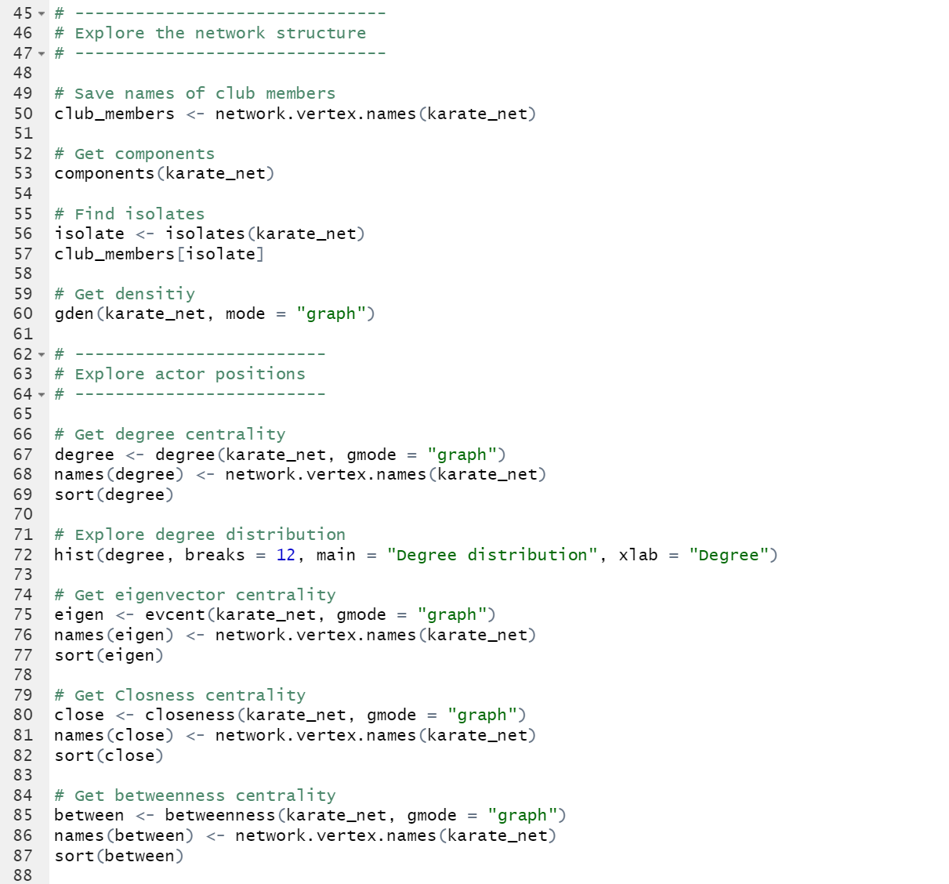
Exploring Network Structure and Node Positions

Slide 20
Discussing the findings
Questions
What is interesting about the network structure? Why is it interesting?
What is interesting about individual actors? Why is it interesting?
What does this tell us about the karate club?
How could you further explore your ideas?
Additional information Mr. Hi is the trainer and John A is the club president.

Slide 21
Discussing the findings
Story
“At the beginning of the study, there was an incipient conflict between the club president, John A., and Mr. Hi over the price of karate lessons. Mr. Hi, who wished to raise prices, claimed the authority to set his own lesson fees, since he was the instructor. John A., who wished to stabilize prices, claimed the authority to set the lesson fees since he was the club's chief administrator.
As time passed the entire club became divided over this issue, and the conflict became translated into ideological terms by most club members. The supporters of Mr. Hi saw him as a fatherly figure who was their spiritual and physical mentor, and who was only trying to meet his own physical needs after seeing to theirs. The supporters of John A. and the other officers saw Mr. Hi as a paid employee who was trying to coerce his way into a higher salary.
[…]
During the factional confrontations […], the club meeting remained the setting for decision making. If, at a given meeting, one faction held a majority, it would attempt to pass resolutions and decisions favorable to its ideological position. The other faction would then retaliate at a future meeting when it held the majority, by repealing the unfavorable decisions and substituting ones favorable to itself. Thus, the outcome of any crises was determined by which faction was able to “stack” the meetings most successfully.“ (Zachary, 1977, p.453)

Slide 22
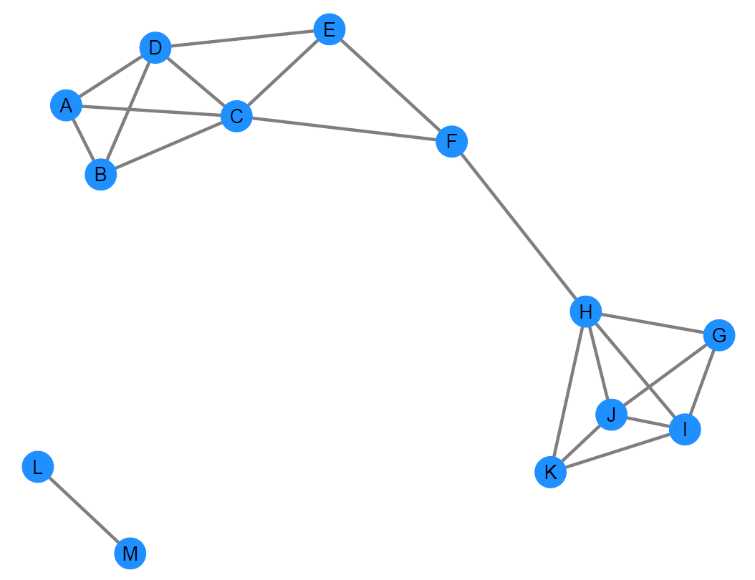
Looking at subgroups
Cliques Maximal complete subgraph Can be overlapping
Notes:
A clique is a subset of nodes where each node has a tie to every other node in the subset.
It would also be impossible to add any more nodes to the clique without violating this condition.

Slide 23
Looking at subgroups
Cliques Maximal complete subgraph Can be overlapping
Notes:
Structural cohesiveness
- One way to look at cliques would be to identify a set of nodes all connected one another (the maximal set)
- A 2 clique can sometimes be described as a clique with paths of two connections

Slide 24
Looking at subgroups
Cliques Maximal complete subgraph Can be overlapping Limitation: Find “communities”
Communities Mutually exclusive sub-groups
Notes:
So what are communities? Communities can be thought of as cohesive sub-groups that can be shown by fragmenting the network.
There are usually a few nodes that if removed would create these fragments and find these subgroups. The nodes that fragment the network can be seen as most important, depending on your research question.

Slide 25
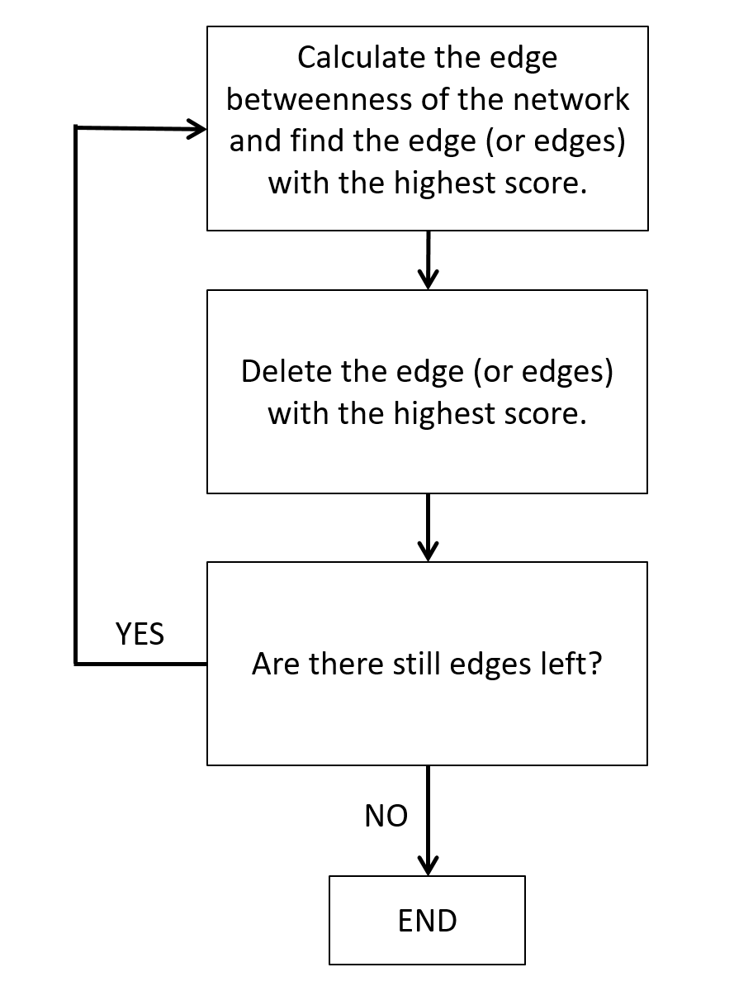
Looking at subgroups
Cliques Maximal complete subgraph Can be overlapping Limitation: Find “communities
Communities Mutually exclusive sub-groups Many different algorithms Girvan-Newman algorithm
Girvan-Newman algorithm (schematic)
Notes:
Review algorithm: The removal of edges that connect the network create communities

Slide 26
Looking at subgroups
Cliques Maximal complete subgraph Can be overlapping Limitation: Find “communities
Communities Mutually exclusive sub-groups Many different algorithms Girvan-Newman algorithm
Girvan-Newman algorithm (schematic)

Slide 27
Looking at subgroups
Cliques Maximal complete subgraph Can be overlapping Limitation: Find “communities
Communities Mutually exclusive sub-groups Many different algorithms Girvan-Newman algorithm
Girvan-Newman algorithm (schematic)

Slide 28
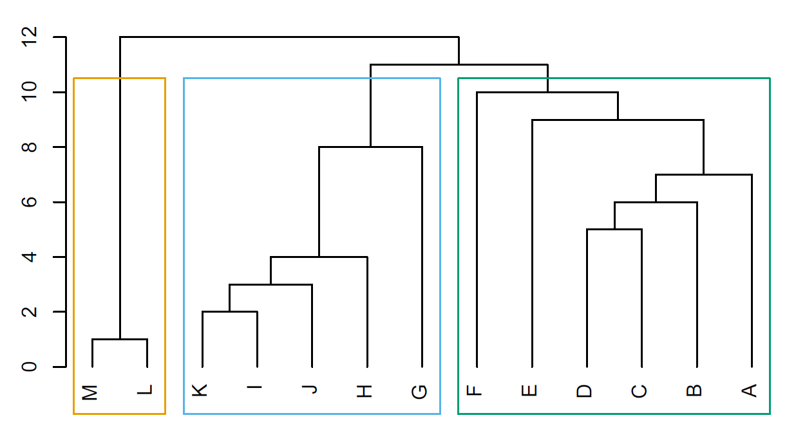
Looking at subgroups
Cliques Maximal complete subgraph Can be overlapping Limitation: Find “communities
Communities Mutually exclusive sub-groups Many different algorithms Girvan-Newman algorithm
Girvan-Newman algorithm (schematic)

Slide 29
Clique
“A clique is a subset of actors in which every actor is adjacent to every other actor in the subset, and it is impossible to add any more actors to the clique without violating this condition. Formally, a clique is defined as a maximal complete subgraph (Luce and Perry 1949). ‘Complete’ means that every node in the clique is adjacent to every other. ‘Maximal’ means that every node in the clique still have it to be complete.” (Borgatti, Everett, & Johnson, 2013, p.183)
Community/ Girvan-Newman algorithm
“One approach to finding cohesive subgroups is to try to find the structurally important edges whose removal fragments the network rather than finding cohesive groups directly. These edges cannot be within the cohesive groups and so must be between them. The removal of these edges will leave just the cohesive groups. This is the approach taken by the Girvan-Newman algorithm (Girven and Newman 2002).” (Borgatti, Everett, & Johnson, 2013, p.195)
Looking at subgroups
(textbook definitions)

Slide 30
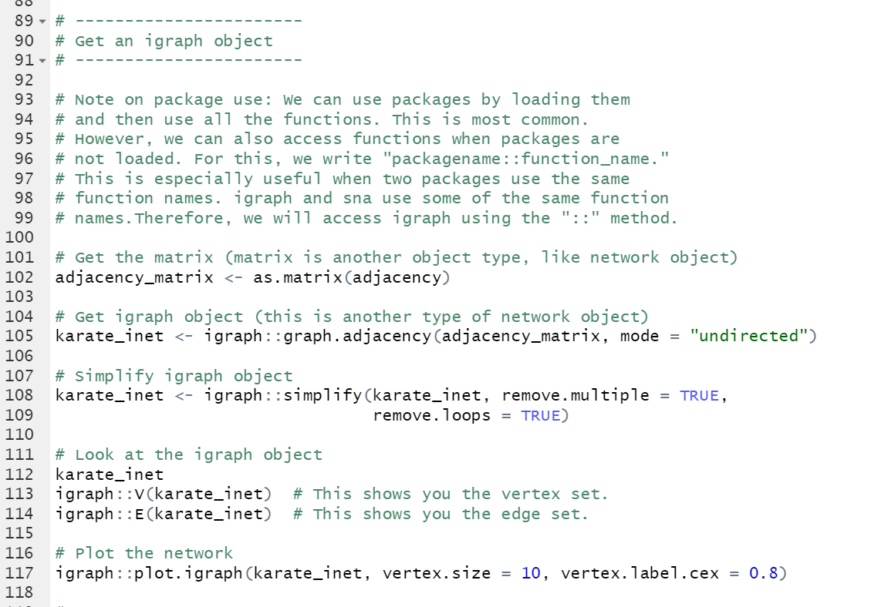
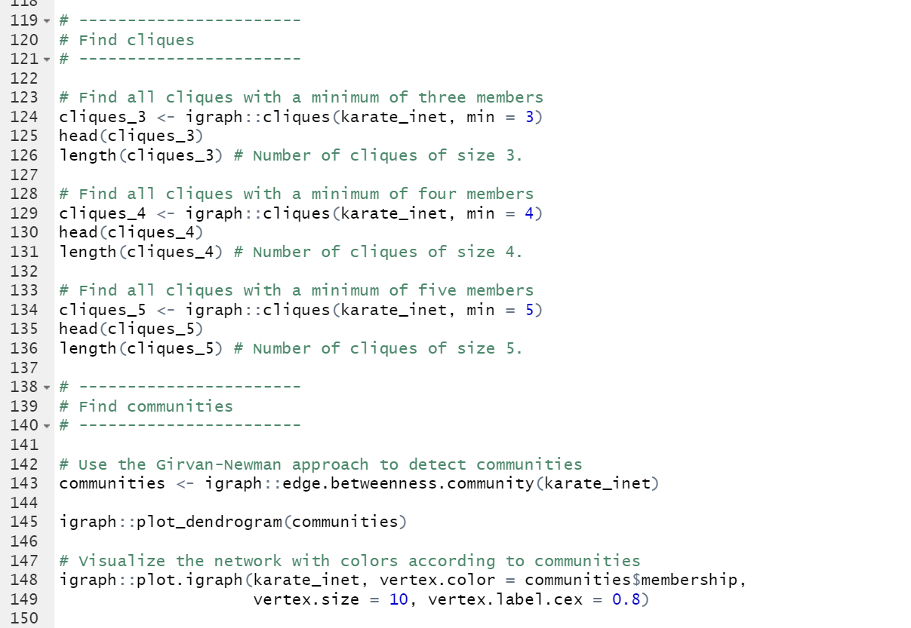
Looking at subgroups

Slide 31
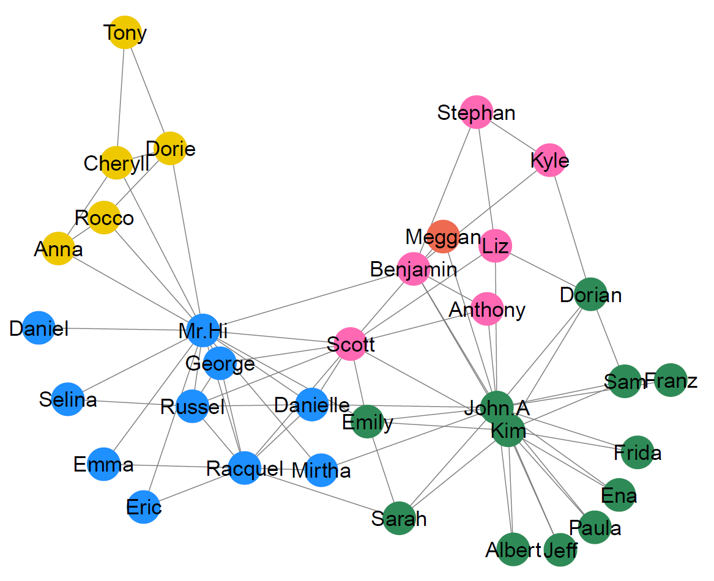
Looking at subgroups
Communities

Slide 32
Observation Zachary
“The factions were merely ideological groupings, however, and were never organizationally crystallized. There was an overt sentiment in the club that there was no political division, and the factions were not named or even recognized to exist by club members.” (Zachary, 1977, p.454)
Formulating hunches
Additional data
Zachary collected data on ideology.
Ideology was recorded as binary information with a modifier (e.g., “Mr. Hi—strong” or “John A.—weak”)
Questions
Looking at the network structure, does this observation make sense to you? Why?
What is your hunch about the relationship between ideologies and interaction? Why do you think that?

Slide 33
male
likes hiking
female
likes hiking
Characteristics of nodes (e.g., ideologies) are called node attributes
Homophily: People are more likely to connect with others who are similar.
Social influence: People “learn” or “adopt” from others with whom they are connected.
→ Network segregation
male
likes bowling
female
likes hiking
Notes:
Side note:
Structural holes – a competitive advantage for a node with linkages spanning different groups resulting from effective non-redundant connections.
Or
“…Structural hole: a gap between two individuals with complementary resources or information. When the two are connected through a third individual as entrepreneur, the gap is filled, creating important advantages for the entrepreneur.” (Burt, 1995)
Constraint, measure of ability to bridge structural holes, the higher the transitivity, the higher the constraint

Slide 34
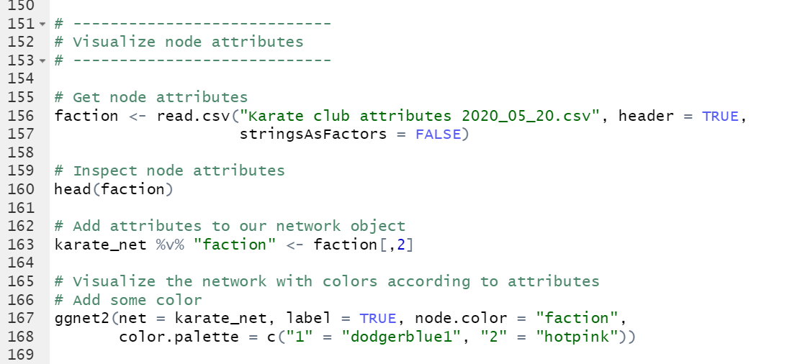
Add node attributes

Slide 35
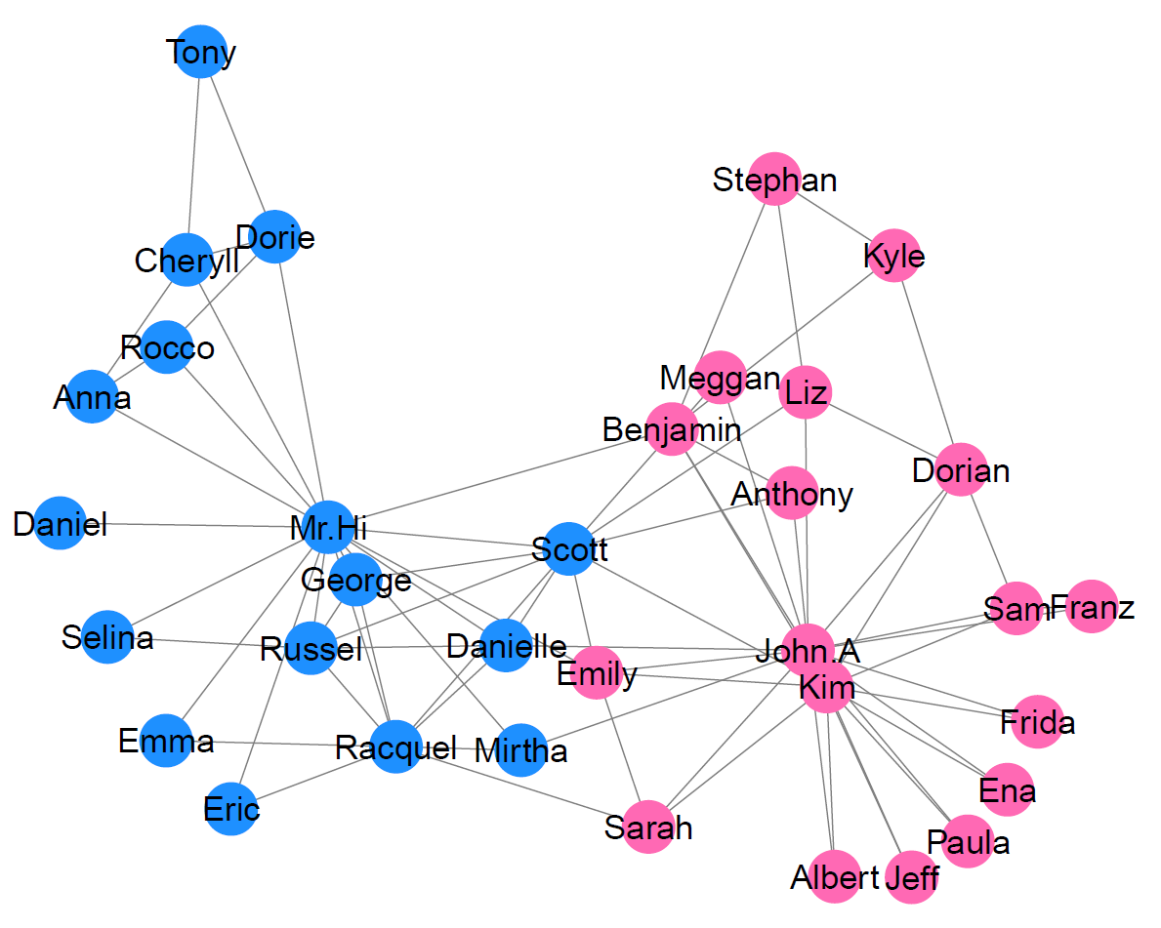
Add node attributes

Slide 36
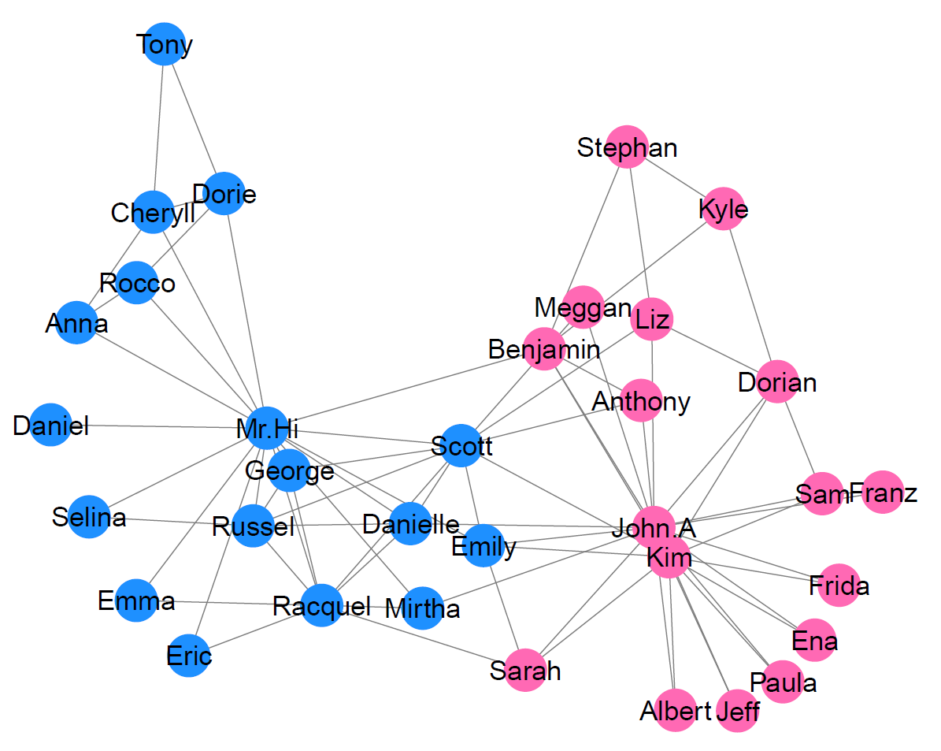
Add node attributes
Faction
Club membership after fission

Slide 37
Fission of the club (story end)
“Rather, they [factions] were merely groups which emerged from the existing network of friendship among club members at times of political crisis because of ideological differences. There was no attempt by anyone to organize or direct political strategies of groups, and, in general, there was no barrier to interaction between members of opposing faction. Only at time of direct political conflict did individuals selectively interact with others who shared the same ideological position, to the exclusion of those holding other positions. […] Political crisis, then, also had the effect of strengthening the friendship bonds within these ideological groups, and weakening the bonds between them, by the pattern of selective reinforcement.” (Zachary, 1977, p.454)
“After a series of increasingly sharp factional confrontations over the price of lessons, the officers, led by John A., fired Mr. Hi for attempting to raise lesson prices unilaterally. The supporters of Mr. Hi retaliated by resigning and forming a new organization headed by Mr. Hi, thus completing the fission of the club.” (Zachary, 1977, p.453)
“Person number 9 [here: Emily] was a weak supporter of Jon but joined Mr. Hi’s club after the split. This can be explained by noting that he was only three weeks away from a test for the black belt (master status) when the split in the club occurred. Had he joined the officers’ club he would have had to give up his rank and begin again in a new style of karate with a white (beginner’s) belt, since the officers had decided to change the style of karate practiced in their new club.” (Zachary, 1997, pp.465-466)
Faction
Club membership after fission

Slide 38
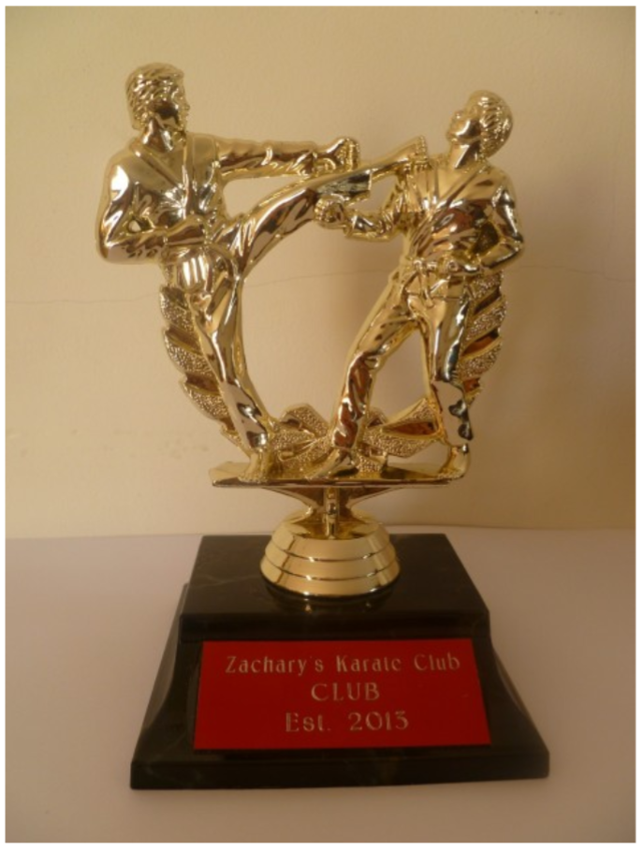
Recap
You have learned basic network concepts …
nodes, edges, & node attributes
graph characteristics
data format
network structure
actor position
subgroups
homophily & social influence
You have ...
visualized a network
explored overall network structure
explored actor positions
identified cliques & communities
formulated and explored network-relevant hunches
analyzed one of the most prominent datasets in the network literature
Traveling trophy of the Zachary Karate Club Club

Slide 39
Sources
Borgatti, S.P., Everett, M.G., & Johnson, J.C. (2013). Analyzing Social Networks. London: SAGE. Note LB: This book is great for learning network concepts. Keep in mind that the book uses UCINET. UCINET is an alternative network analysis software (like R or Python).
Burt, Ronald (1995) Structural Holes. Harvard University Press; 1st Paperback Edition
Csardi, G. (2015). igraphdata: A Collection of Network Data Sets for the 'igraph' Package. R package version 1.0.1. https://CRAN.R-project.org/package=igraphdata.
Zachary, W.W. (1977). An Information Flow Model for Conflict and Fission in Small Groups. Journal of Anthropological Research 33(4), 452-473.
Graphs “Networks are everywhere …”
LinkedIn Connections: https://brettsadler77.wordpress.com/2013/10/28/linkedin-maps-visualise-your-network/
London underground: http://www.bbc.co.uk/london/travel/downloads/tube_map.html
Shipping network: https://nicolasrapp.com/studio/portfolio/the-shipping-news/
Marine ecosystem network: https://www.researchgate.net/figure/Food-web-linkages-in-the-HB-ecosystem-with-respect-to-trophic-level-horizontal-lines_fig5_313557078
Graph “Recap”
Traveling trophy of the Zachary Karate Club Club: http://mae.engr.ucdavis.edu/dsouza/Classes/S18-ECS253/Lectures/communities2018.pdf

Slide 40
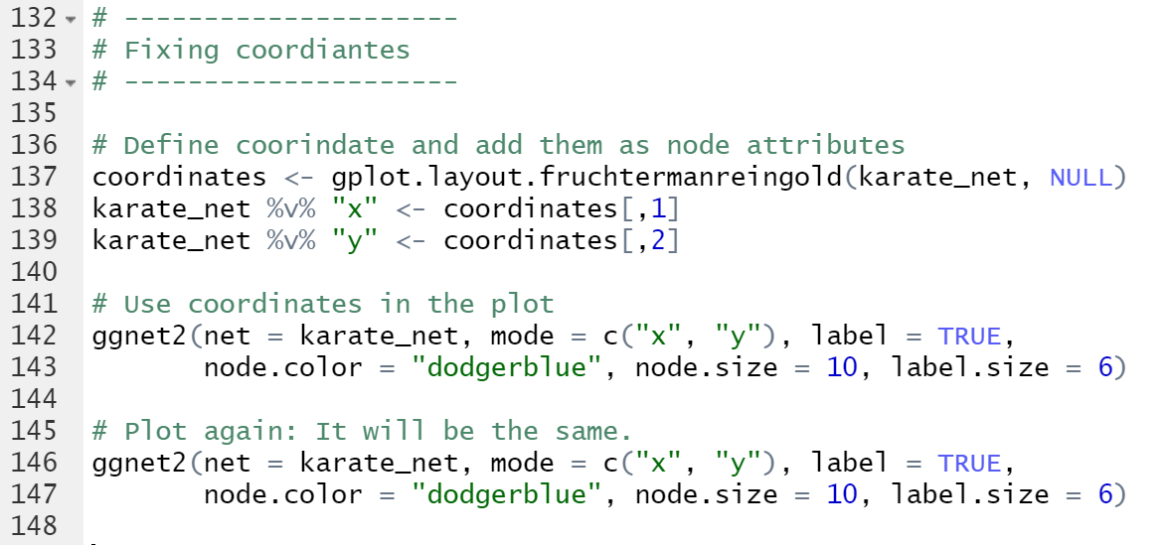
Addition: Fixing coordinates for plotting (question asked by participant)

